Slide 1

Artificial intelligence, machine learning and data-driven methods to model complex problems
ModelFLOWs
Soledad Le Clainche
School of Aerospace Engineering
Universidad Politécnica de Madrid (UPM)
soledad.leclainche@upm.es
https://sites.google.com/view/soledadleclainche
Universidad Politécnica de Madrid

Slide 2
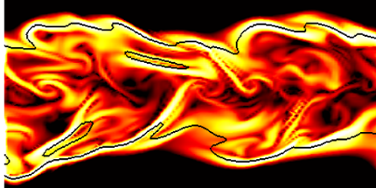
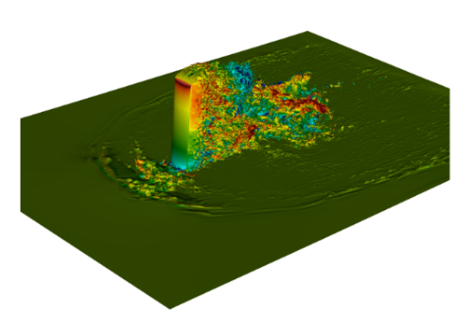
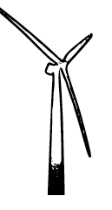
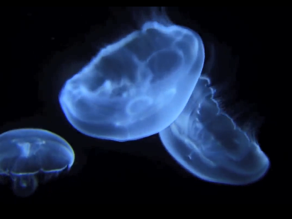
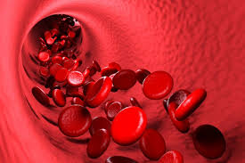
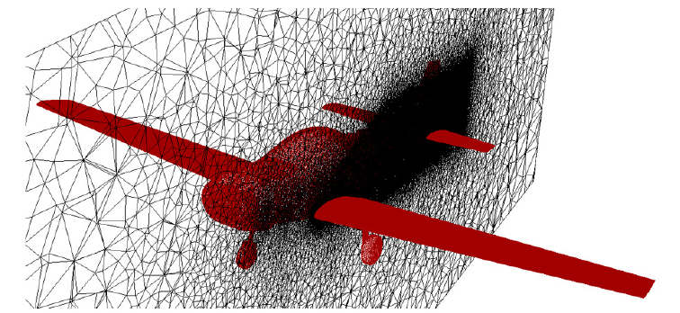
CFD simulations & Data-driven tools: applications
Marine propulsion
Medicine &
Non-Newtonian flows
Aerodynamics & Aeroelasticity
Combustion
Urban flows
Wind Energy
Artificial intelligence tools: reduced order models
Study and understand database general behaviour
Deeper understanding of physics
Reduce computational cost
Control & design optimization
Universidad Politécnica de Madrid

Slide 3
Methods for data analysis
Reduced order model
Data analysis
Data-driven methods
Equation-based methods
E.g.: Galerkin projection
Modal decomposition
Neural networks
Machine learning & Artificial intelligence
Universidad Politécnica de Madrid

Slide 4
Methods for data analysis
Artificial intelligence tools
Reduced Order Models: hybrid machine learning models based on physical principles
+
Modal decomposition
Neural networks
Recurrent Neural Networks,
Convolutional Neural Networks,
Autoencoders, Transformers, PINNs, etc.
Data forecasting
Data reconstruction & repairing
etc.
DMD, POD, PCA, HOSVD, HODMD, etc.
Extract physical patterns
Reduce data dimensionality
Data assimilation to develop robust architectures
Combine numerical and experimental databases
Universidad Politécnica de Madrid

Slide 5
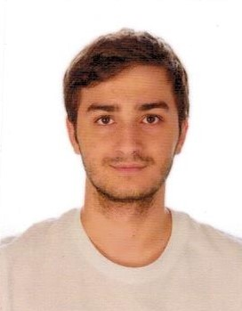

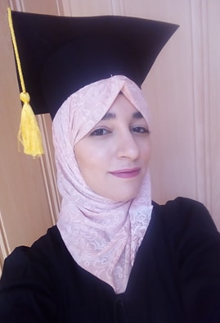
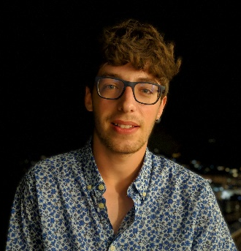
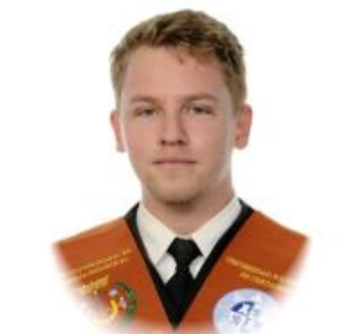
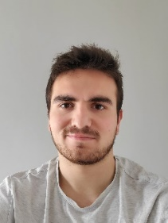
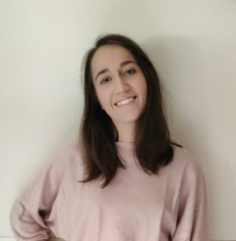
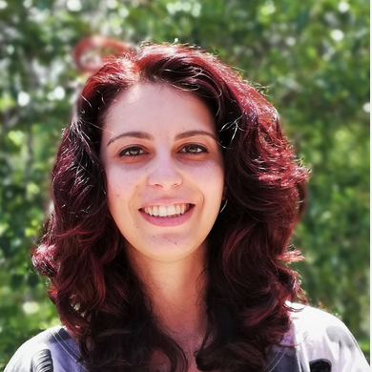
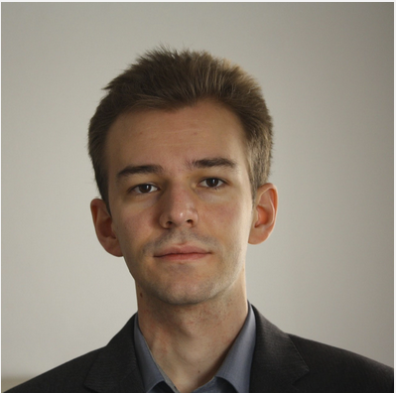
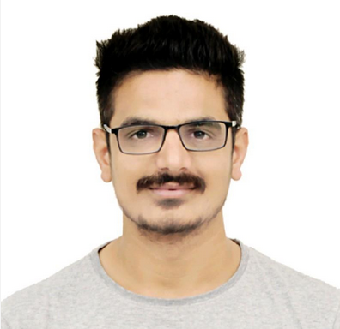
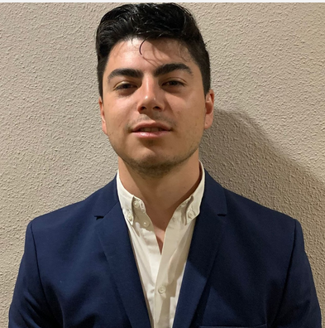
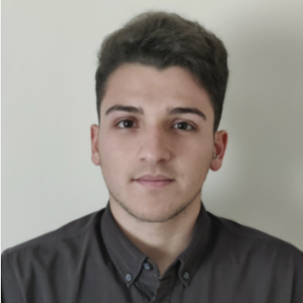
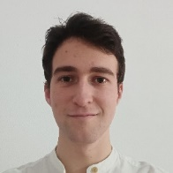
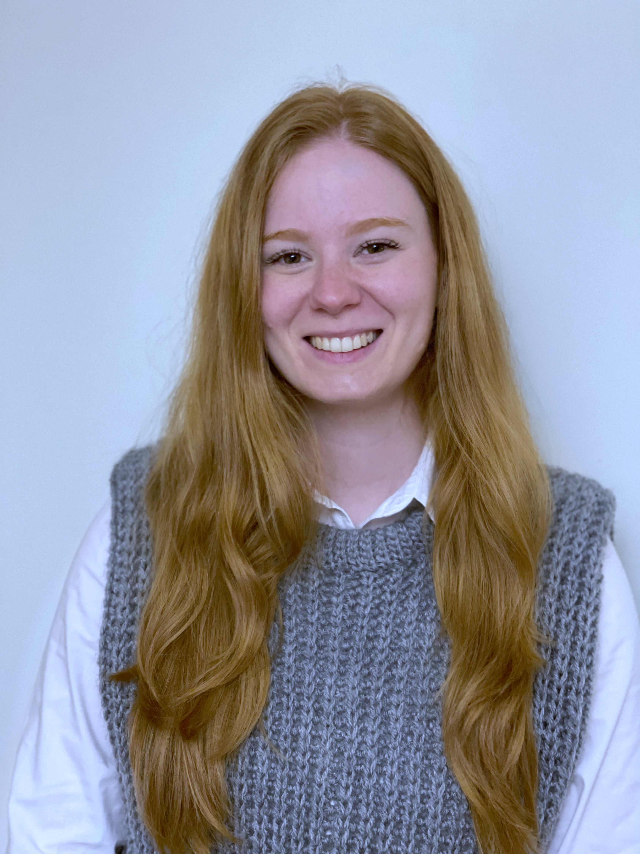
ModelFLOWs - Research Group
Adrián Corrochano
Rodrigo Abadía-Heredia
Nourel Groun
Eneko Lazpita
Christian Amor
Ashton Ian Hetherington
Andrés Bell
Mahesh Nagargoje
Daniel Serfaty
Juan Sánchez
Eva Muñoz
Sofia Tagliaferro
Egoitz Maiora
Paula Díaz
Universidad Politécnica de Madrid
https://sites.google.com/view/soledadleclainche/research-group-modelflows

Slide 6
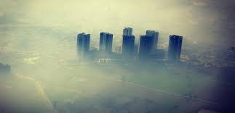
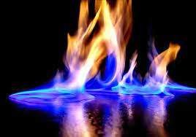
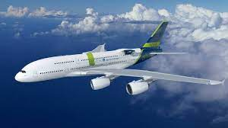
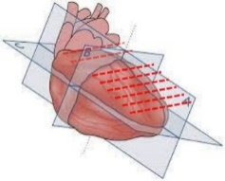





Funded projects in ModelFLOWs
Fight climate change & advance in personalized medicine
Artificial intelligence tools & CFD simulations
MODEL-CO,
ENCODING
NEMDAEA
DigitHEART,
CardioAging
MODELAIR
Universidad Politécnica de Madrid

Slide 7
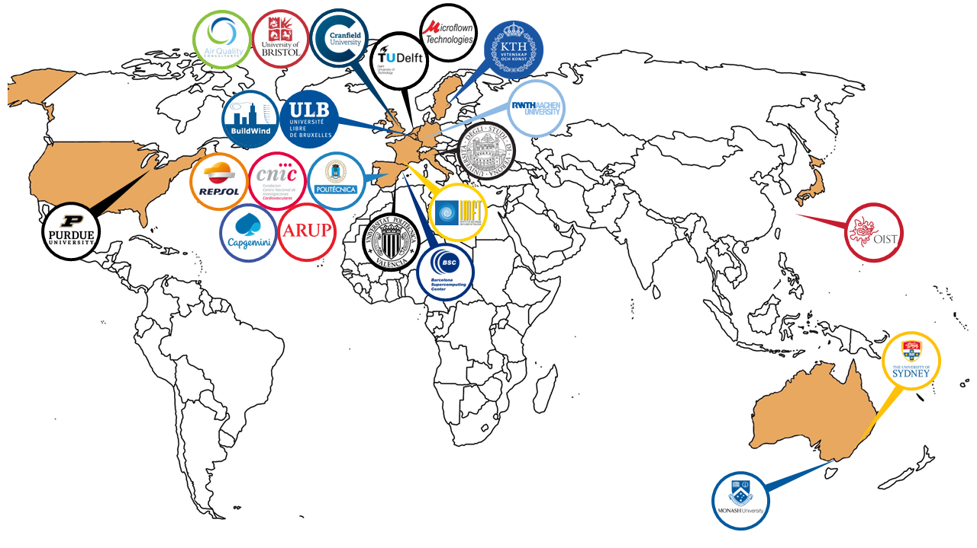
ModelFLOWs national & international collaborations
Universidad Politécnica de Madrid

Slide 8
Open Source Software
ModelFLOWs
APP
MODAL DECOMPOSITION
DEEP LEARNING
Pattern detection
Reconstruction
Prediction
Pattern detection
Reconstruction
Prediction
HOSVD
Data Repairing
HODMD
Autoencoders
Superresolution
Full DL
HODMD
Superresolution
Hybrid
https://modelflows.github.io/modelflowsapp/
Universidad Politécnica de Madrid

Slide 9
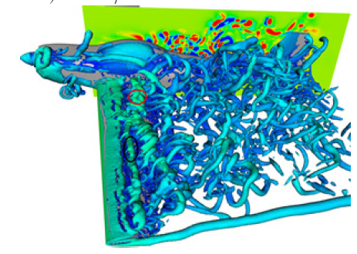
Open Source Software
ModelFLOWs
APP
Big databases
CPU & GPU
Universidad Politécnica de Madrid

Slide 10
Open Source Software
ModelFLOWs
APP
MODAL DECOMPOSITION
DEEP LEARNING
Pattern detection
Reconstruction
Prediction
Pattern detection
Reconstruction
Prediction
HOSVD
Data Repairing
HODMD
Autoencoders
Superresolution
Full DL
HODMD
Superresolution
Hybrid
https://modelflows.github.io/modelflowsapp/
Universidad Politécnica de Madrid

Slide 11
Open Source Software
ModelFLOWs
APP
MODAL DECOMPOSITION
DEEP LEARNING
Pattern detection
Reconstruction
Prediction
Pattern detection
Reconstruction
Prediction
HOSVD
Data Repairing
HODMD
Autoencoders
Superresolution
Full DL
HODMD
Superresolution
Hybrid
https://modelflows.github.io/modelflowsapp/
Universidad Politécnica de Madrid

Slide 12
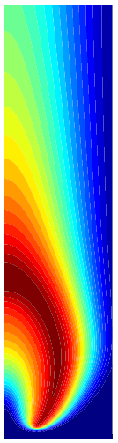
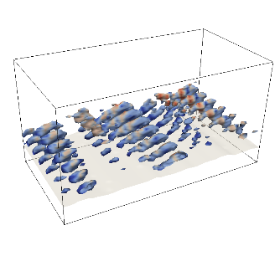
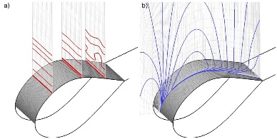
ModelFLOWs App – Patterns detection
Marine propulsion
Combustion
Urban flows
Medicine
Aerodynamics
Combustion
Aerodynamics
Turbulence, Heat transfer, Flight test, Wind energy
Reactive flows
Corrochano, D’Alessio, Parente, Le Clainche (arxiv, 2022)
Corrochano, Freitas, Parente, Le Clainche (ISUDEF, 2022)
Le Clainche, Rosti & Brandt (J. Fluid Mech. 2022)
Le Clainche, Izbassarov, Rosti, Brandt & Tammisola (J. Fluid Mech. 2020)
Méndez, Le Clainche, Moreno, Vega (Arosp. Sci. Tech. 2021)
Le Clainche, Zhan & Ferrer (Phys. Fluids 2019)
Wu et al. (Chin. J. Aero., 2019)
Méndez, Le Clainche, Vega, Moreno, Taylor (AIAA 2019)
Le Clainche, Mao & Vega (Wind Energ. 2018)
Le Clainche, Moreno, Taylor, Vega (J. Aircraft 2018)
Le Clainche, Pérez & Vega (Fluid Dyn. Res. 2018)
Le Clainche, Sastre, Vega & Velázquez (AIAA 2017)
Universidad Politécnica de Madrid

Slide 13
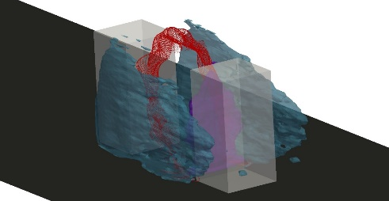
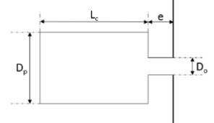

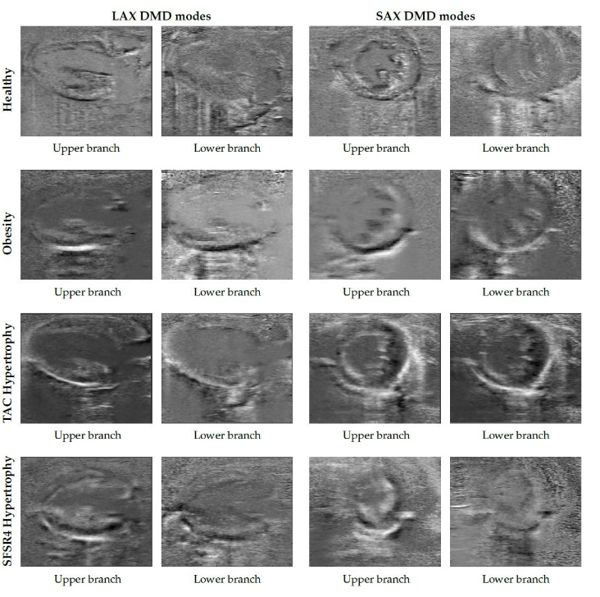
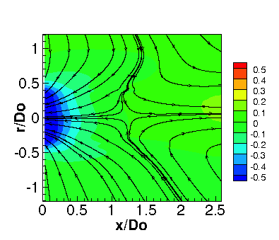
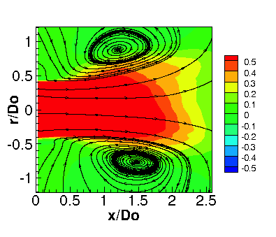
ModelFLOWs App – Patterns detection
Urban flows
Marine propulsion
Combustion
Urban flows
Marine propulsion
Medicine
Aerodynamics
Medicine
Synthetic jets
Medical Imaging
Urban flows
Muñoz & Le Clainche (Phys. Fluids, 2022)
Le Clainche (Energies 2019)
Palomo, Pérez & Le Clainche (RIENG 2019)
Le Clainche, Vega & Soria (Exp. Therm. Fluid Sci. 2017)
Groun, Villalba, Lara, Valero, Garicano & Le Clainche (Comp. Biol. Med. 2022)
Vega & Le Clainche (Book - Elsevier 2020)
Groun et al. (Com. Biol. Med., 2022)
Lazpita et al. (Phys. Fluids 2022)
A. Martínez-Sánchez et al. (J. Fluid Mech., submitted)
Multi-phase flows
Non-newtonian flows
etc.
Universidad Politécnica de Madrid

Slide 14
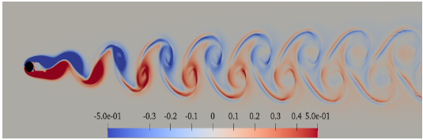
Pattern detection - New strategies for flow control
New algortihm fully data-driven to detect structural sensitivity → applications in flow control
Application to an ElastoViscoPlastic flow past a cylinder 2D
Corrochano & Le Clainche,
Comp. & Maths. with Appl., 2022
In collaboration with S. Parvar & O. Tammisola
Re = 100
Wi = 1
Bn = 2
n = 0.2
β = 0.9
Universidad Politécnica de Madrid

Slide 15
Pattern detection - New strategies for flow control
Creation of a new algortihm based on HODMD (fully data-driven) for flow control
Application to an ElastoViscoPlastic flow past a cylinder 2D
FOTO DE MODOS DEL CILINDRO DIRECTO Y ADJUNTO???
Re = 100
Wi = 1
Bn = 2
n = 0.2
β = 0.9
Universidad Politécnica de Madrid

Slide 16
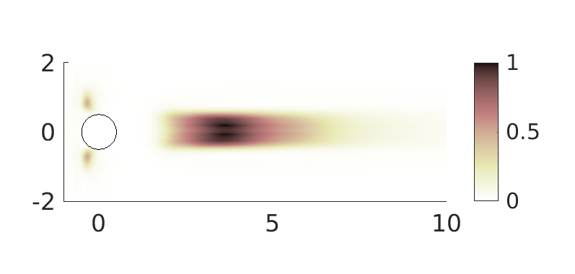
Pattern detection - New strategies for flow control
Creation of a new algortihm based on HODMD (fully data-driven) for flow control
Application to an ElastoViscoPlastic flow past a cylinder 2D
Re = 100
Wi = 1
Bn = 2
n = 0.2
β = 0.9
Universidad Politécnica de Madrid

Slide 17
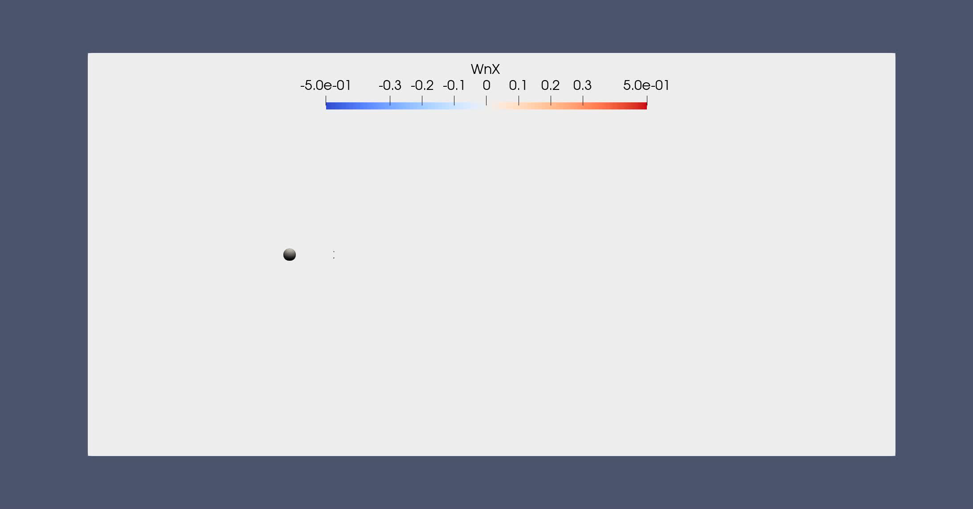
Pattern detection - New strategies for flow control
Creation of a new algortihm based on HODMD (fully data-driven) for flow control
Application to an ElastoViscoPlastic flow past a cylinder 2D
Re = 100
Wi = 1
Bn = 2
n = 0.2
β = 0.9
Universidad Politécnica de Madrid

Slide 18
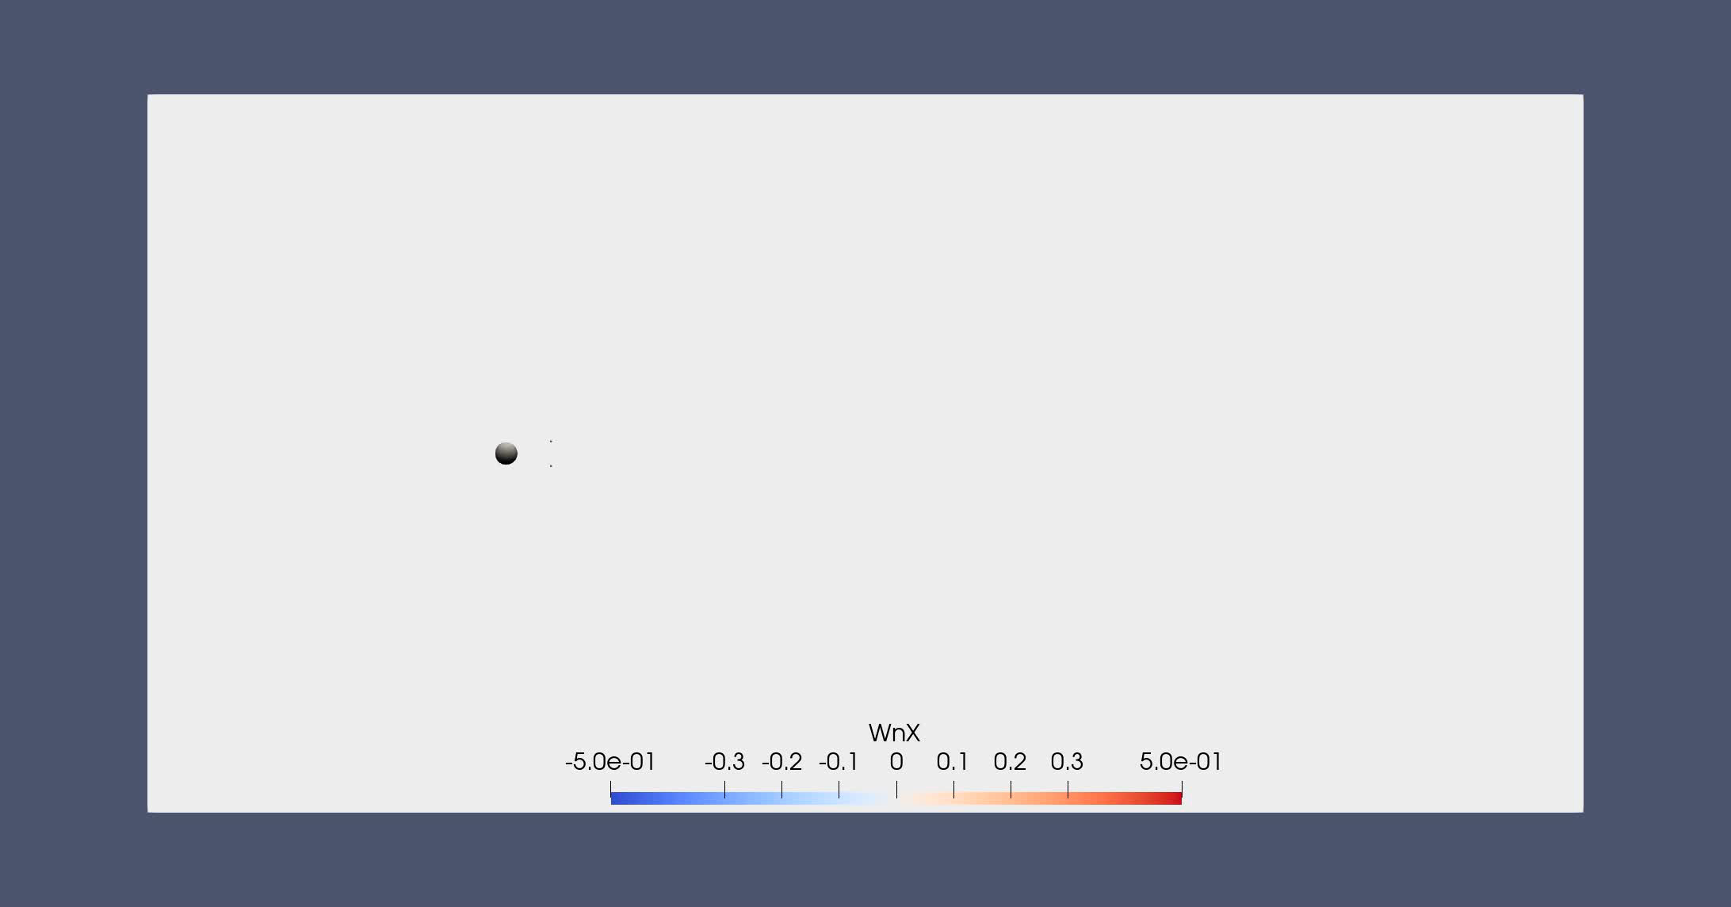
Pattern detection - New strategies for flow control
Creation of a new algortihm based on HODMD (fully data-driven) for flow control
Application to an ElastoViscoPlastic flow past a cylinder 2D
Re = 100
Wi = 1
Bn = 2
n = 0.2
β = 0.9
Universidad Politécnica de Madrid

Slide 19
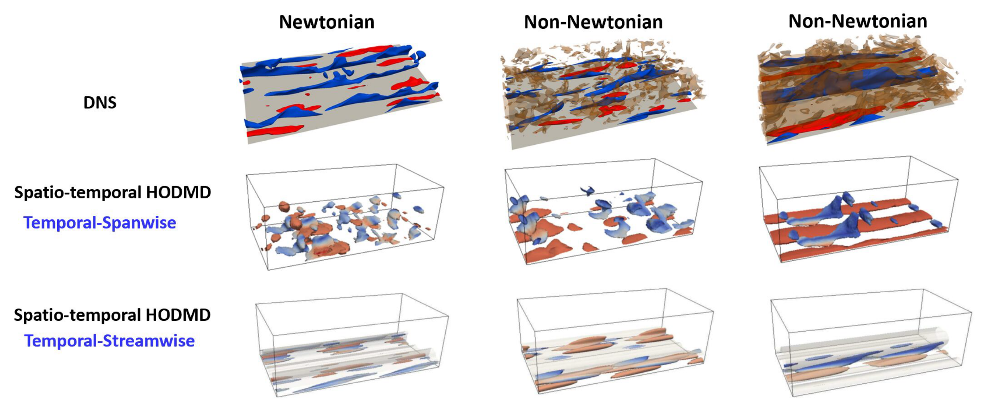
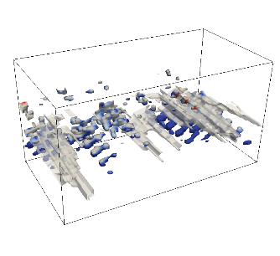
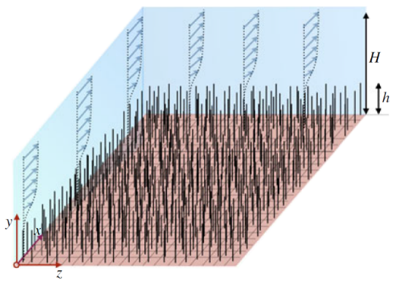
ModelFLOWs App – Patterns detection
More applications
Flow instabilitites in wall bounded turbulence
Global and convective cross-flow instabilitites
Transition to turbulence in wakes
Porous wall
Canopy
Universidad Politécnica de Madrid

Slide 20
Open Source Software
ModelFLOWs
APP
MODAL DECOMPOSITION
DEEP LEARNING
Pattern detection
Reconstruction
Prediction
Pattern detection
Reconstruction
Prediction
HOSVD
Data Repairing
HODMD
Autoencoders
Superresolution
Full DL
HODMD
Superresolution
Hybrid
https://modelflows.github.io/modelflowsapp/
a)
Universidad Politécnica de Madrid

Slide 21
Open Source Software
ModelFLOWs
APP
MODAL DECOMPOSITION
DEEP LEARNING
Pattern detection
Reconstruction
Prediction
Pattern detection
Reconstruction
Prediction
HOSVD
Data Repairing
HODMD
Autoencoders
Superresolution
Full DL
HODMD
Superresolution
Hybrid
https://modelflows.github.io/modelflowsapp/
a)
Universidad Politécnica de Madrid

Slide 22
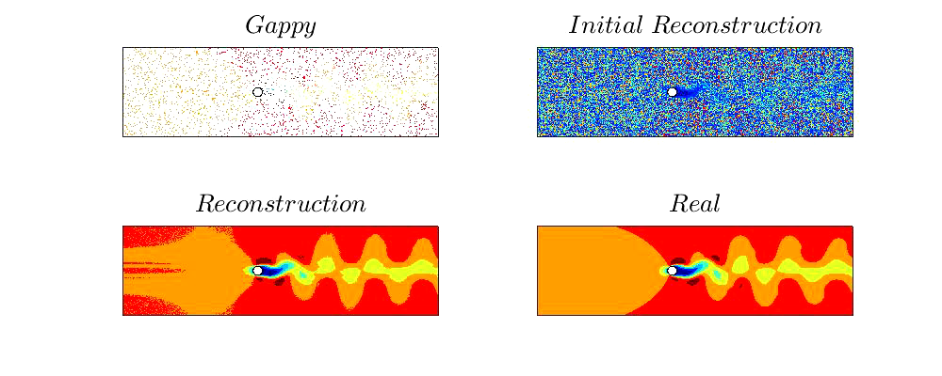
ModelFLOWs App – Reconstruction
Data repairing & enhacement of resolution
RRMSE: 2%
a)
Universidad Politécnica de Madrid

Slide 23
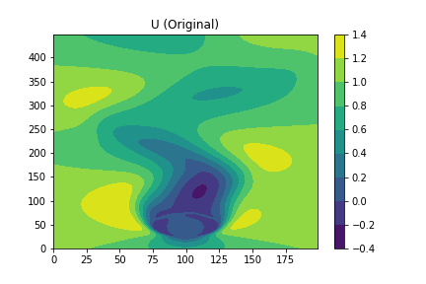

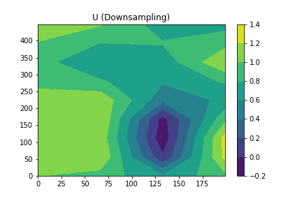
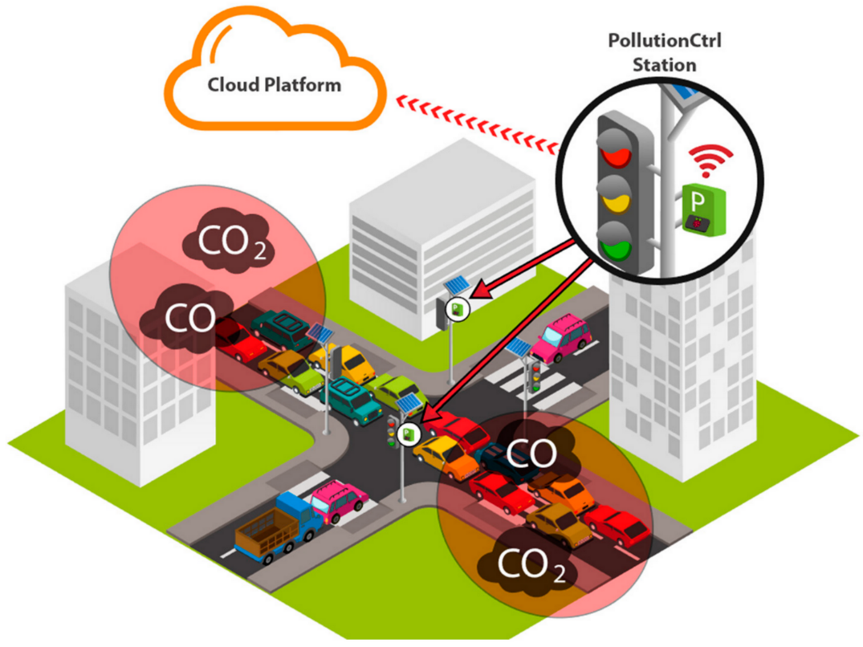
ModelFLOWs App – Reconstruction
From sensors to 3D fields
Original
Sensors
Input database
Reconstruction
RRMS error < 2%
ROM
Sensors in cities
3D pollution maps
a)
Universidad Politécnica de Madrid

Slide 24
Open Source Software
ModelFLOWs
APP
MODAL DECOMPOSITION
DEEP LEARNING
Pattern detection
Reconstruction
Prediction
Pattern detection
Reconstruction
Prediction
HOSVD
Data Repairing
HODMD
Autoencoders
Superresolution
Full DL
HODMD
Superresolution
Hybrid
https://modelflows.github.io/modelflowsapp/
a)
Universidad Politécnica de Madrid

Slide 25
Open Source Software
ModelFLOWs
APP
MODAL DECOMPOSITION
DEEP LEARNING
Pattern detection
Reconstruction
Prediction
Pattern detection
Reconstruction
Prediction
HOSVD
Data Repairing
HODMD
Autoencoders
Superresolution
Full DL
HODMD
Superresolution
Hybrid
https://modelflows.github.io/modelflowsapp/
a)
Universidad Politécnica de Madrid

Slide 26
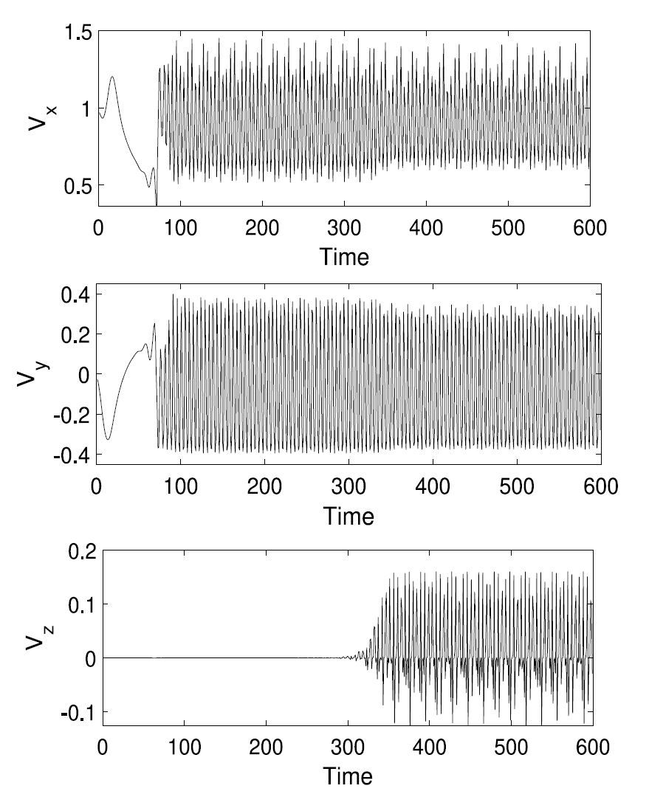
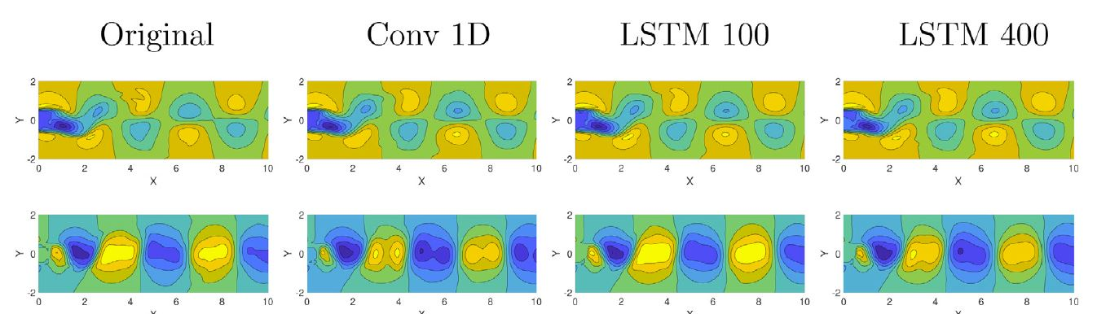
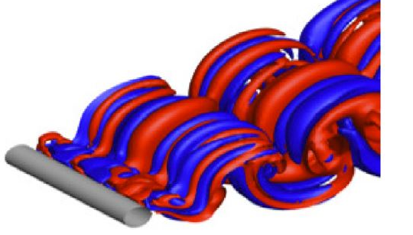
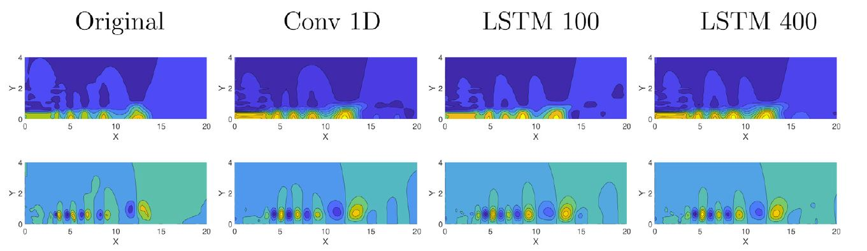
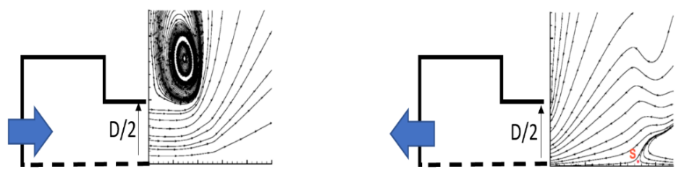
ModelFLOWs App – Prediction
Training + validation
Speed-up numerical simulations
RRMS error ~ 2% & Speed-up >100!!
Prediction
a)
Universidad Politécnica de Madrid

Slide 27
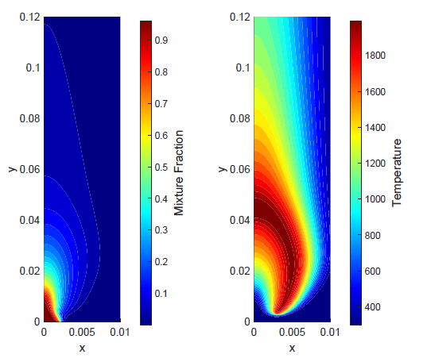





ModelFLOWs App – Prediction
Training + validation
Speed-up numerical simulations
Reactive flows
82 Chemical species
Real
Prediction
Multiphase flows
Shock wave with ‘buffeting condition’
Wind turbines
Prediction
a)
Universidad Politécnica de Madrid

Slide 28



ModelFLOWs App – Prediction
Open-door measurements
Predict flutter in flight test
Predict wind velocity in LiDAR experiments
228 m
LiDAR device
Automatic method (errors smaller than 5%), identify flutter modes in less than 2 minutes!
200 m
20 m
RRMS error ~ 2%
a)
Universidad Politécnica de Madrid

Slide 29
Open Source Software
ModelFLOWs
APP
MODAL DECOMPOSITION
DEEP LEARNING
Pattern detection
Reconstruction
Prediction
Pattern detection
Reconstruction
Prediction
HOSVD
Data Repairing
HODMD
Autoencoders
Superresolution
Full DL
HODMD
Superresolution
Hybrid
https://modelflows.github.io/modelflowsapp/
a)
Universidad Politécnica de Madrid

Slide 30
Thank you for your attention!
Questions??
soledad.leclainche@upm.es
https://sites.google.com/view/soledadleclainche
https://modelflows.github.io/modelflowsapp/
a)
Universidad Politécnica de Madrid

